Slide 1

Edge AI: Running Artificial Intelligence on IOT devices
DR. BABASAHEB AMBEDKAR TECHNOLOGICAL UNIVERSITY, LONERE
Department of Computer Engineering
Under the Guidance of
Prof. Vrunda Bhonkar
PRESENTED BY
SHWETA KONDU KHARADE
PRN NO. 24030331245058
B. TECH. Second Year 2025-2026
COMPUTER ENGINEERING

Slide 2
TABLE OF CONTENTS
Introduction to Edge AI
What is IoT?
Algorithms used in Edge AI
How Edge AI works
Key features of Edge AI
Why Edge AI Instead of Cloud AI
Hardware used in Edge AI
Software and Frameworks
Applications of Edge AI
Edge AI in Smart Homes
Edge AI in healthcare
Advantages of Edge AI
Challenges of Edge AI
Future trends in Edge AI
Case Study : smart traffic management
Edge vs Cloud comparison
Conclusion

Slide 3
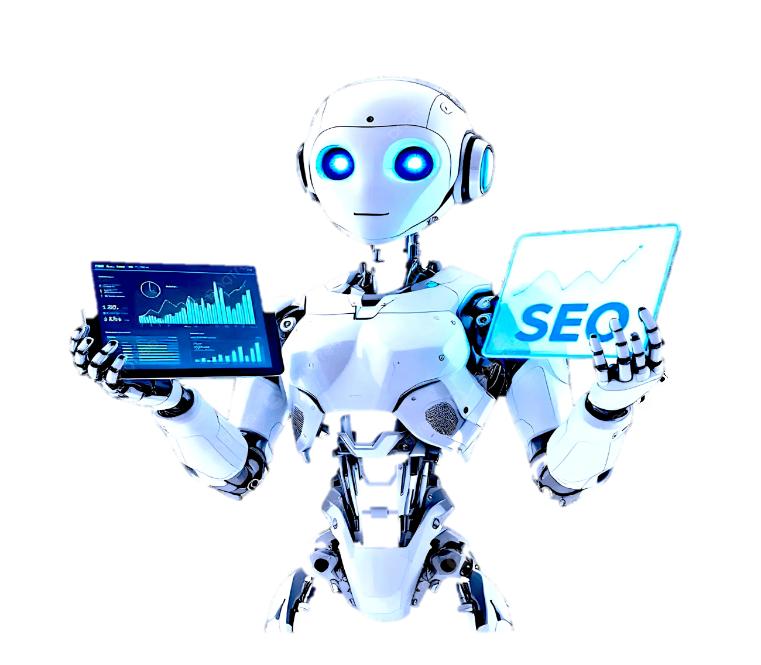
Introduction to Edge AI
Edge AI = AI processing done directly on edge devices
Works without sending all data to cloud
Reduces delay and improves speed
Useful for IoT systems
Combines AI + embedded hardware
Fig. 1

Slide 4
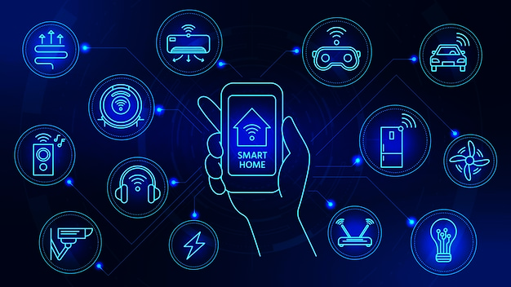
What is IoT?
IoT = network of connected smart devices
Devices collect and exchange data
Needs fast decision-making
Examples: smart home gadgets, sensors
Edge AI makes IoT smarter and autonomous
Fig. 2

Slide 5
Algorithms used in Edge AI
Convolutional Neural Networks (CNNs): Used for image and video recognition on edge devices.
Recurrent Neural Networks (RNNs) / LSTMs: Handle sequential data like speech or sensor readings.
Decision Trees & Random Forests: Lightweight models for fast predictions on small devices.
TinyML (Tiny Machine Learning): Runs optimized AI models on low-power microcontrollers.
Federated Learning: Trains models locally on multiple devices without sharing private data.

Slide 6

1. CNN Inference Algorithm :
Input: Image I, Filters F[], Stride s
Output: FeatureMap FM
for each filter f in F:
for each region R of I with step = s:
conv_sum = 0
for i in R:
conv_sum += I[i] * f[i]
FM_cell = max(0, conv_sum) // ReLU
store FM_cell in FM
return FM

Slide 7
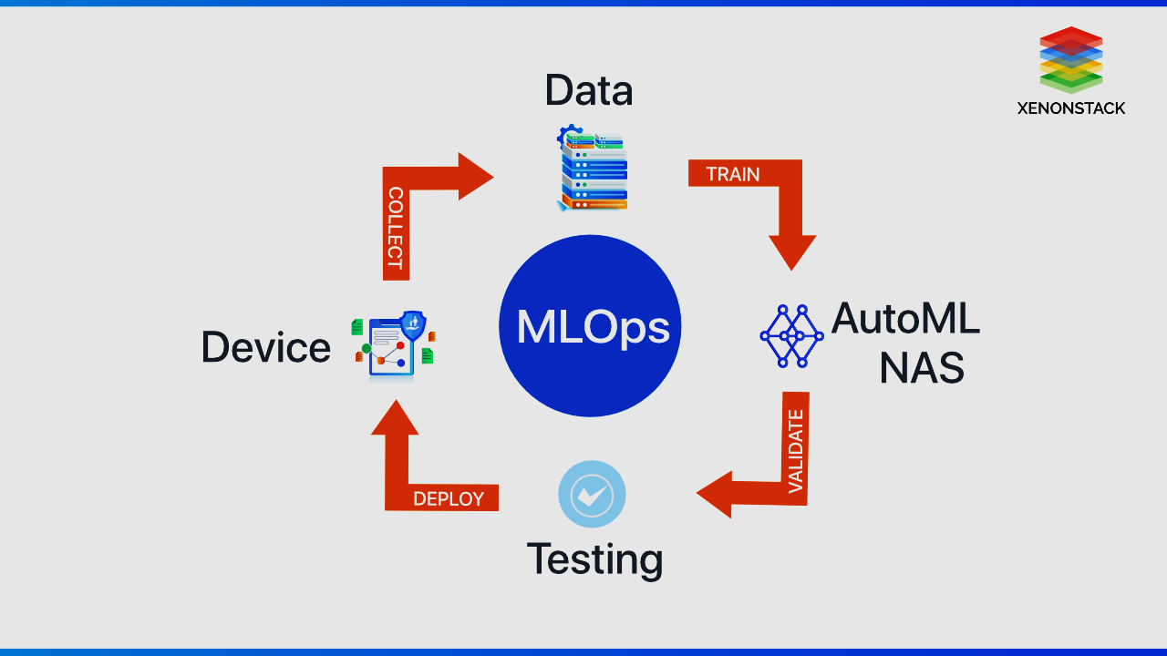
2. TinyML Decision Tree Algorithm
Input: sensor_value x
Output: class_label
if x < T1:
if x < T2:
return "Normal"
else:
return "Warning"
else:
if x > T3:
return "Critical"
else:
return "Fault"

Slide 8
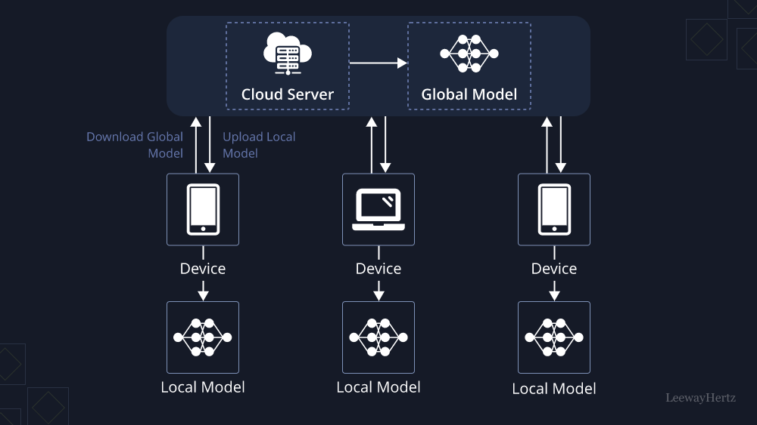
3. Federated Learning Algorithm
Server:
Input: Global model W
Repeat for each round:
Send model W to selected IoT devices
For each device k in parallel:
W_k = LocalTrain(W, data_k)
W = Average(W_k from all devices)
Return final global model

Slide 9
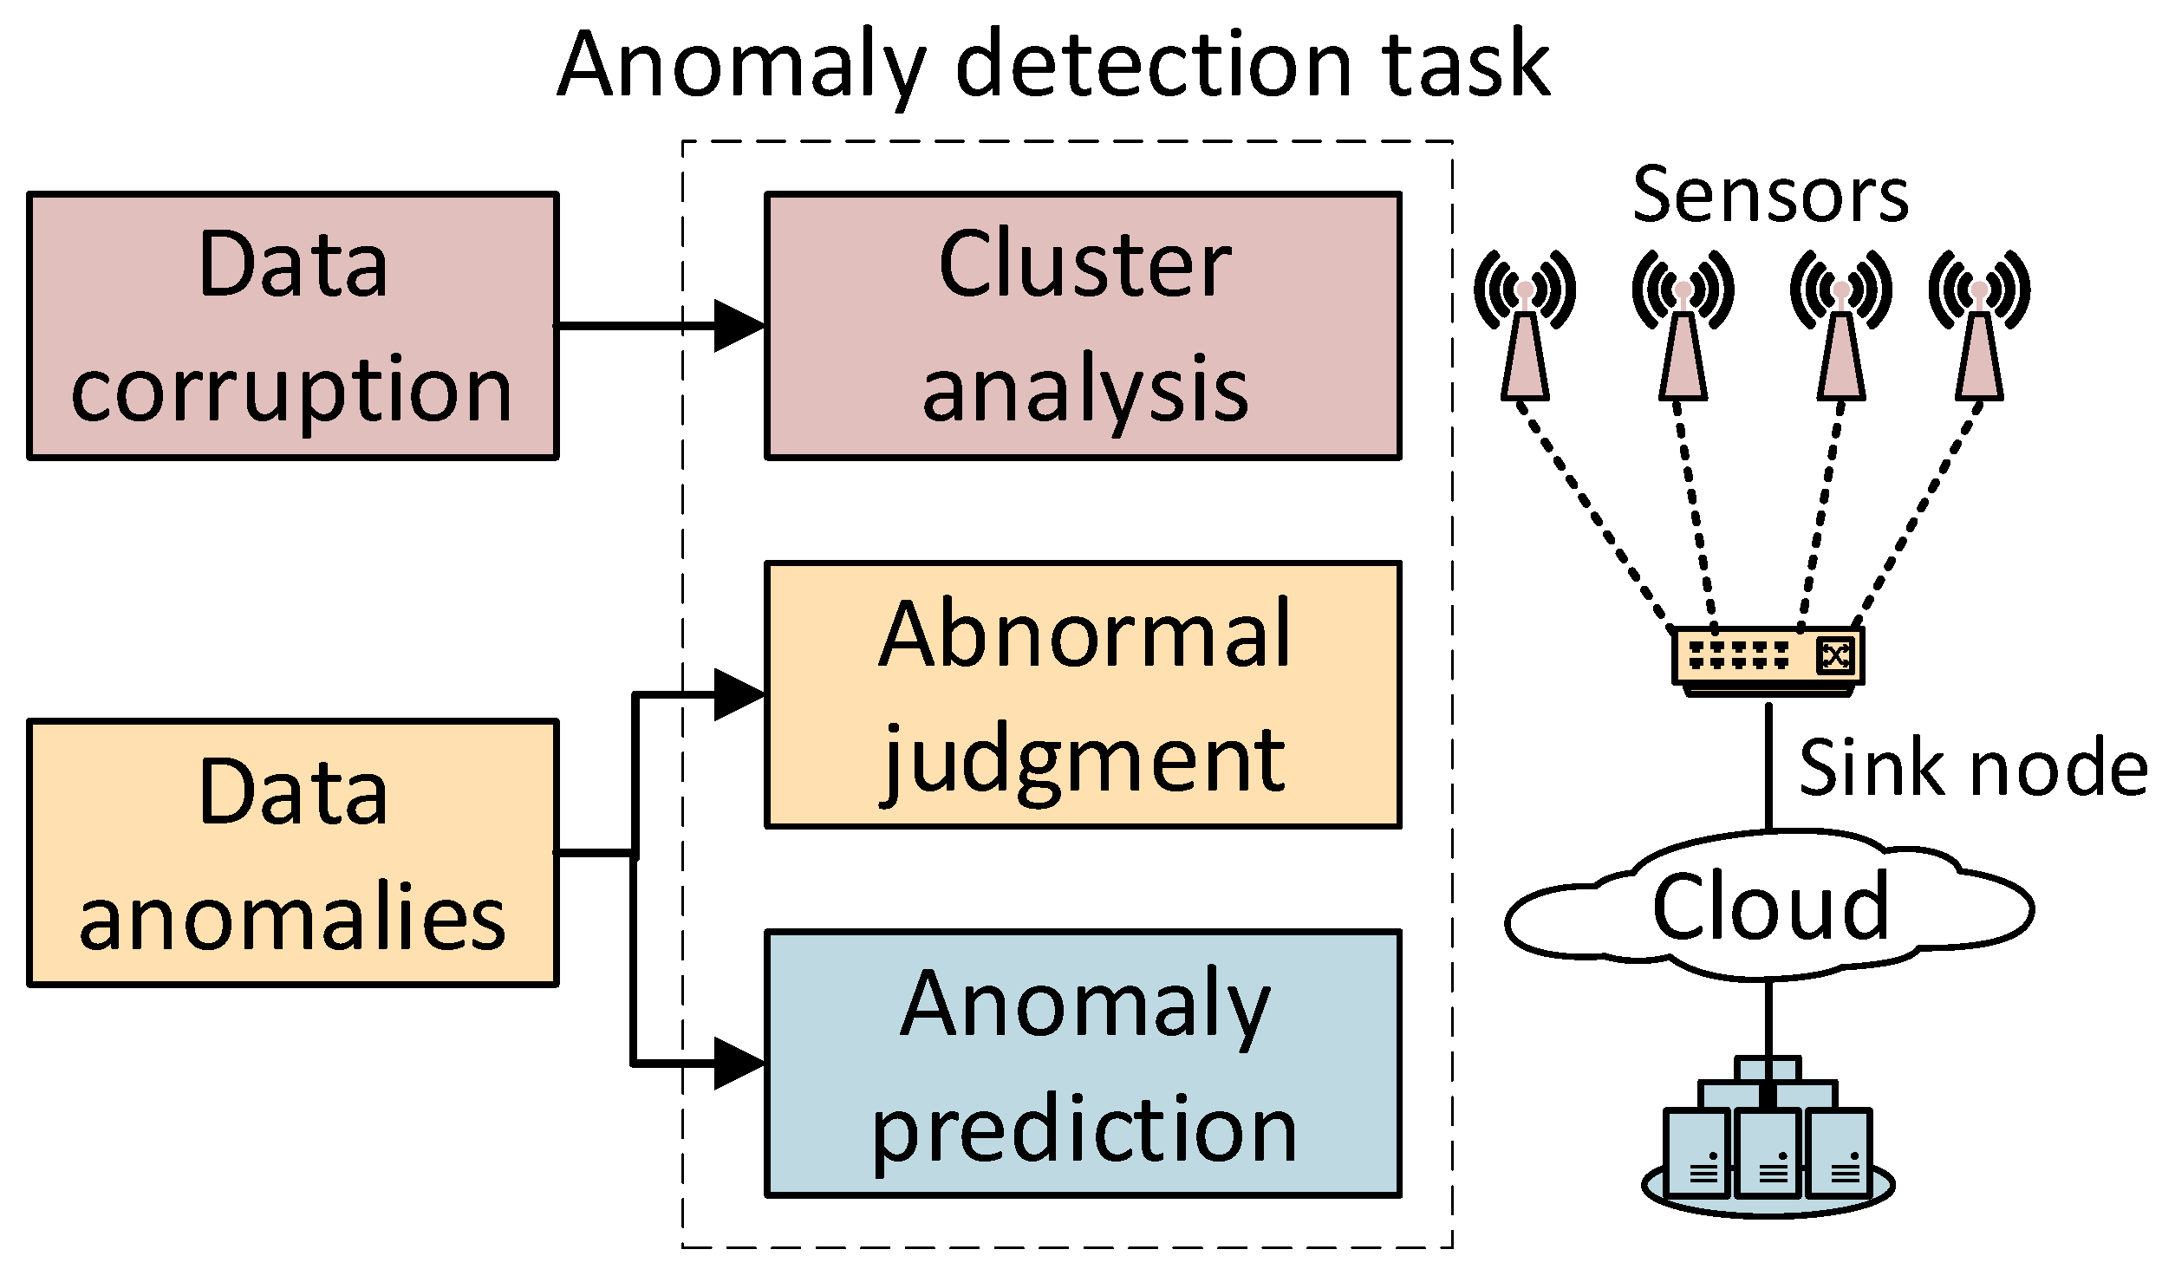
3. Edge Anomaly Detection Algorithm
Input: new_value x
Output: anomaly or normal
Compute mean μ from last N values
Compute std deviation σ from last N values
Z = (x - μ) / σ
if abs(Z) > 2:
return "Anomaly"
else:
return "Normal"

Slide 10
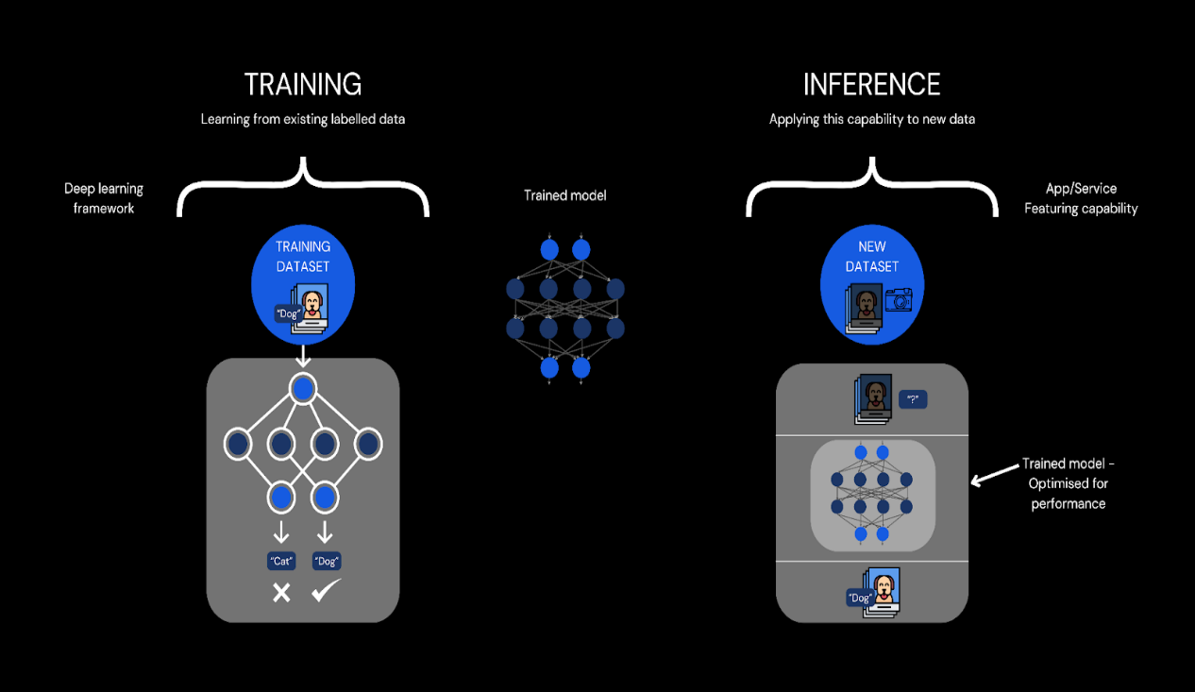
How Edge AI Works
Devices collect sensor data
AI models run locally on hardware
Local inference gives instant output
Only essential data sent to cloud
Enables autonomous decision-making
Fig. 5

Slide 11

Why Edge AI Instead of Cloud AI?
Cloud processing causes delay
Requires continuous internet
Higher bandwidth usage
Privacy risks with cloud storage
Edge AI solves these limitations
Fig. 3

Slide 12

Key Features of Edge AI
Ultra-low latency
On-device data processing
Higher security and privacy
Works offline
Real-time analytics
Lower operational cost
Fig. 4

Slide 13
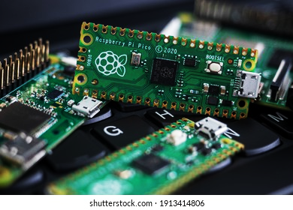
Hardware Used in Edge AI
Edge processors (ARM, RISC-V)
Microcontrollers (ESP32, Arduino)
AI accelerators (Coral TPU, NVIDIA Jetson)
Smart cameras and sensors
Low-power GPUs / NPUs
Fig. 6

Slide 14



Software & Frameworks
TensorFlow Lite
PyTorch Mobile
OpenVINO
Edge Impulse
ONNX Runtime
Lightweight model formats
Fig. 7

Slide 15
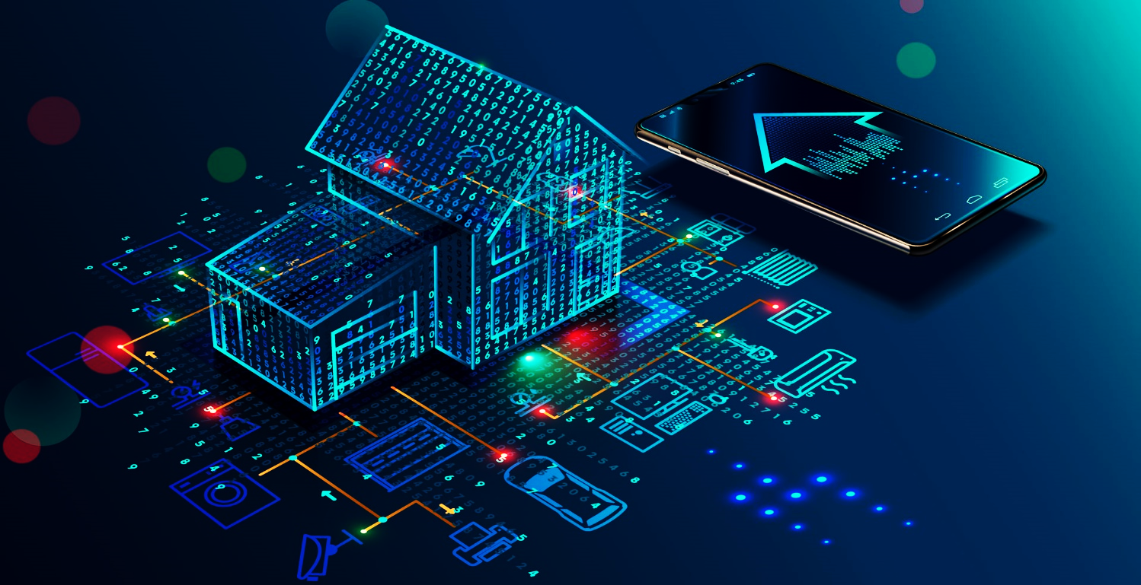
Applications of Edge AI
Smart agriculture automation
Self-driving or assisted vehicles
Health monitoring wearables
Industrial predictive maintenance
Smart security cameras
Home automation
Fig. 8

Slide 16
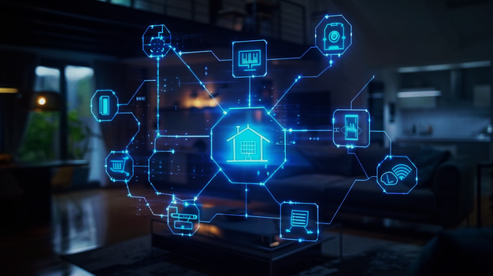
Edge AI in Smart Homes
Voice assistants respond faster
Cameras detect intrusions locally
Energy optimization systems
Smart thermostats
Personalized automation
Reduced dependency on internet
Fig. 9

Slide 17

Edge AI in Healthcare
Real-time patient monitoring
Predicts abnormal heart rates
AI-enabled diagnostic devices
Wearables track health continuously
Provides offline emergency alerts
Fig. 10

Slide 18

Advantages of Edge AI
Faster decision-making
Improved user privacy
Lower latency
Reduced network load
Offline capability
Lower long-term cost
Fig. 11

Slide 19
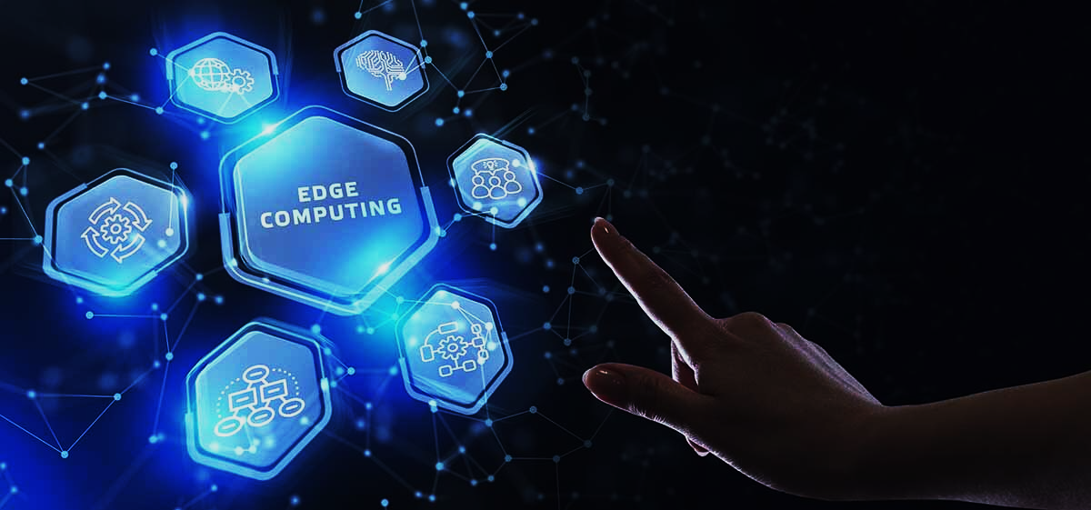
Challenges of Edge AI
Limited device memory
Power constraints
Hardware cost initially
Complex model optimization
Security vulnerabilities
Integration difficulties
Fig. 12

Slide 20

Future Trends in Edge AI
More powerful edge chips
Self-learning IoT devices
5G + Edge AI integration
Federated learning development
Ultra-low-power AI modules
Wider industry adoption
Fig. 13

Slide 21
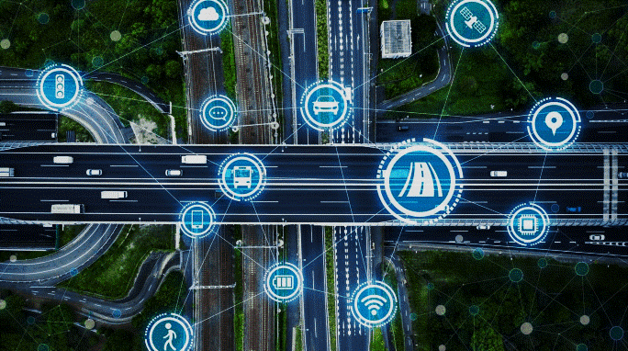
Case Study – Smart Traffic Management
Cameras detect vehicle density
AI adjusts signal timings
Reduces congestion
No internet required
Improves city safety
Real-time monitoring
Fig. 14

Slide 22
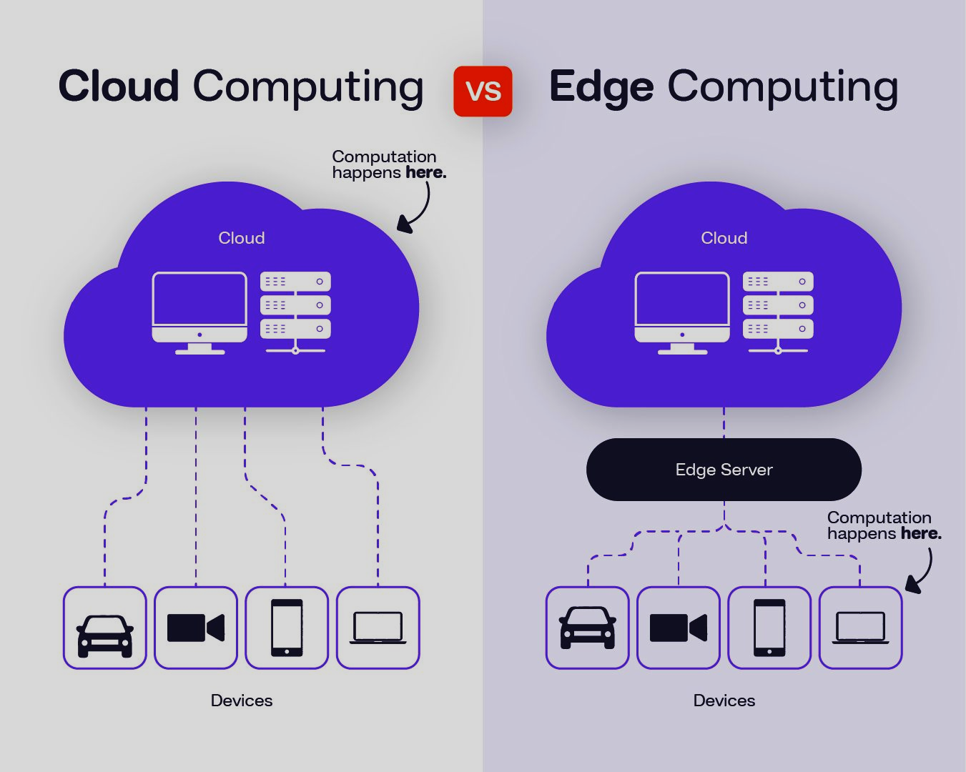
Edge vs Cloud – Comparison
Edge: real-time, private, offline
Cloud: scalable, high compute
Edge reduces cloud pressure
Better reliability in remote areas
Hybrid systems becoming common
Fig. 15

Slide 23
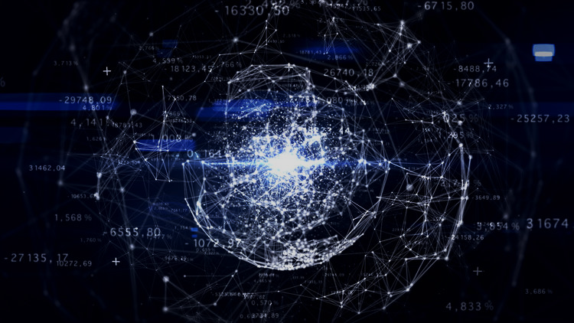
Conclusion
Edge AI brings intelligence close to data
Enhances speed, privacy, and efficiency
Essential for IoT future
Enables autonomous and smart systems
Transforming every sector globally
Fig. 16

Slide 24
REFERENCES
“Efficient Processing of Deep Neural Networks: A Tutorial and Survey” — V. Sze, Y-H. Chen, T-J. Yang, J. Emer. 2017. PDF/ArXiv link
“Edge Intelligence: On-Demand Deep Learning Model Co-Inference with Device-Edge Synergy” — E. Li, Z. Zhou, X. Chen. 2018. ACM DL link
“Edge AI: On-Demand Accelerating Deep Neural Network Inference via Edge Computing” — E. Li, L. Zeng, Z. Zhou, X. Chen. 2019. ArXiv PDF

Slide 25
Thank You !

